Slide 1
TERMS AND CONDITIONS
These PowerPoint slides are a tool for lecturers, and as such:
YOU MAY add content to the slides, delete content from the slides, print out the slides, and save the slides onto your computer or server.
YOU MAY NOT resell, reproduce or redistribute the content in any form whatsoever, without prior written permission from the copyright holder.
© Troupant Publishers (Pty) Ltd, 2016
Selected images used under licence from Shutterstock.com

Slide 2
Engineering Systems
NQF Level 2

Slide 3
Maintaining equipment with simple control systems
Module 14

Slide 4
Caring for and maintaining equipment with simple control systems
Unit 14 .1

Slide 5
Power tools
General basic maintenance and care
Store power tools in a clean place.
Keep power tools oiled.
Clean dust filters.
Do not throw away the manufacturer’s manual for a power tool.
Frequently blow out any dust that may accumulate inside the motor of a power tool.

Slide 6
Power tools
General basic maintenance and care
Frequently inspect blade guards and switches of saws, drills and grinding wheels.
Carefully check cords and plugs of portable power tools.
Use mild soap and a damp cloth to clean a power tool.
Never allow any liquid to enter a power tool. Also, never immerse any part of the tool in a liquid.

Slide 7
Power tools
General basic maintenance and care
Use only genuine parts.
Do not at any time allow brake fluid, petroleum-based products or oil to come into contact with plastic parts because the parts may become weakened and cause injury if they break.

Slide 8
Maintaining and caring for specific power tools and accessories
Drill bits
Learn how to sharpen drill bits.
Keep good-quality bits in a separate box or case rather than allowing them to roll around loose in the toolbox where the cutting edges might be damaged.
Use a coolant to extend the life of the drill bit when drilling.

Slide 9
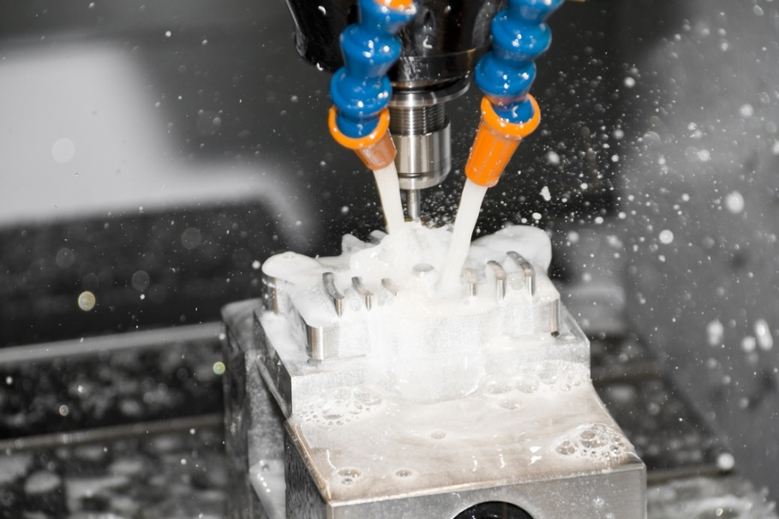
Maintaining and caring for specific power tools and accessories
Drill bits
Figure 14.1 Using coolant while drilling

Slide 10
Maintaining and caring for specific power tools and accessories
Drill press
Periodically lubricate the gear-and-rack table-elevation mechanism, the splines (grooves) in the spindle and the rack (teeth on the quill).
Ensure that the base is properly secured to the workshop floor.
Keep the table and column clean at all times.

Slide 11
Maintaining and caring for specific power tools and accessories
Grinding wheels
Check new wheels for possible transport damage.
Store grinding wheels carefully on wooden racks to avoid damage.
Store small wheels in suitable boxes or drawers in a way that prevents them bumping against one another.

Slide 12
Maintaining and caring for specific power tools and accessories
Grinding wheels
The storeroom must be dry and protected against extremes of temperature or vibration.
Resinoid-bonded grinding wheels should not be stored longer than two to three years.
Vitrified-bonded grinding wheels can be stored indefinitely.

Slide 13
Maintaining and caring for specific power tools and accessories
Jigsaws and bandsaws
Always keep the saw clean. Brush the air vents and the dust extraction port, and wipe the casing clean. Do not use caustic cleaning solutions to clean the plastic housing.
If the saw generates excessive sparks, check the carbon brush.

Slide 14
Maintaining and caring for specific power tools and accessories
Jigsaws and bandsaws
Replace damaged or worn out components with genuine parts.
Lubricate the blade support roller from time to time with a drop of light machine oil.
Keep the table clean at all times.

Slide 15
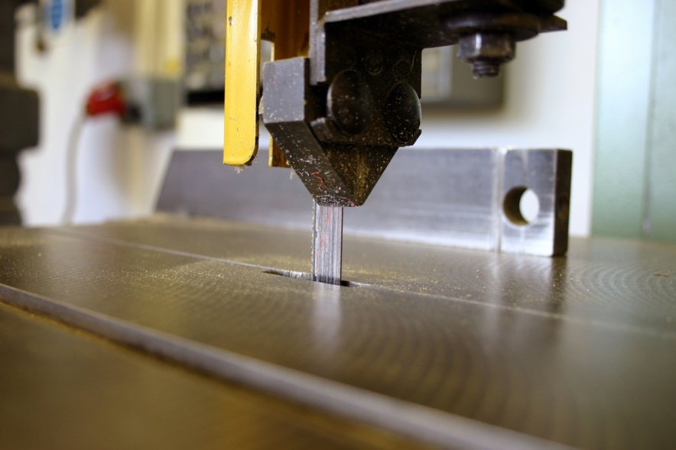
Maintaining and caring for specific power tools and accessories
Jigsaws and bandsaws
Figure 14.2 Clean the work table before and after working

Slide 16
Pneumatic tools
General basic maintenance and care
Ensure that the air supply is maintained at the required pressure.
Regularly check and refill the lubrication to ensure adequate lubrication.
Check for any signs of damage.
Check that the proper attachments or accessories are used.
Do not drag tools by the hose.
Check the specifications of a pneumatic power tool for its ratings.

Slide 17
Environments to avoid for pneumatic tools
Do not use pneumatic tools in an environment where they are directly exposed to corrosive gases, chemicals, salt water, water or steam.
Do not use pneumatic tools in an explosive atmosphere.
Do not mount a pneumatic tool in a location where it is subject to strong vibrations, shocks or radiant heat.

Slide 18
VIDEO: Mabena today

Slide 19
Hydraulic tools
Figure 14.3 A hydraulic floor jack

Slide 20
Inspecting power tools for defects
Check the power cable and plug for damage.
Avoid using adaptors.
Check if the switch is operating satisfactorily and ensure that it has not been bypassed.
Check for a smell of burning.
Ensure that the tool rotates freely without undue noise or strain.

Slide 21
Inspecting power tools for defects
Ensure that the tool does not vibrate excessively when used.
Ensure that the machine does not start and stop after a while.
Check belts for signs of wear or cracks.
Ensure the belts are aligned properly.
Check if accessories are sharp, for example blades and drill bits.

Slide 22
Fault-finding
Fault-finding is done to ensure you have complete understanding using:
Analytical questioning.
Direct observation.

Slide 23
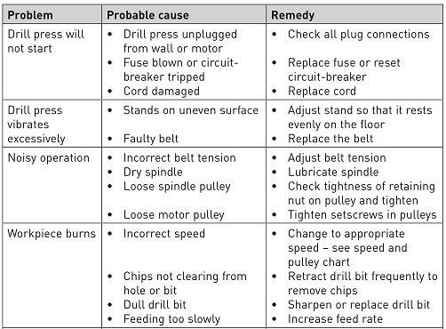
Fault-finding
Table 14.1 Fault-finding guide for a drill press

Slide 24
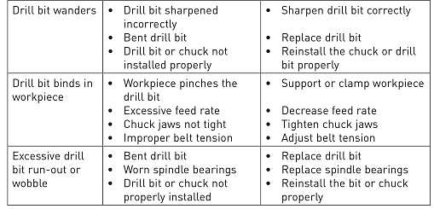
Fault-finding
Table 14.1 Fault-finding guide for a drill press (continued)

Slide 25
Lubrication
Purpose of a lubrication plan.
Lubricating electrical equipment.
Lubricating pneumatic equipment.
Lubricating hydraulic equipment.

Slide 26
Lubrication
Figure 14.5 A grease gun

Slide 27
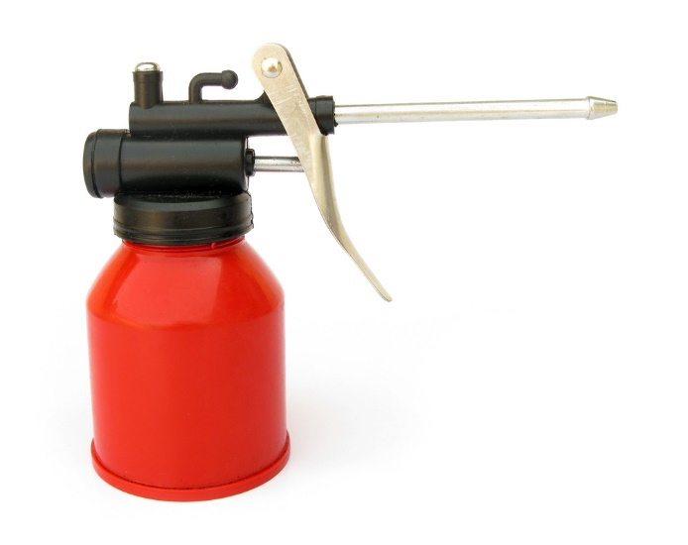
Lubrication
Figure 14.6 An oil can

Slide 28
Starting the equipment and compiling a post-maintenance report
Unit 14 .2

Slide 29
Starting the equipment after maintenance
General guidelines:
Ensure that the work area is clean and tidy.
Pack all tools away in the correct storage place.
Return all temporary connections to normal.
Remove all jumpers use for shorting connections (e.g. when testing).

Slide 30
Starting the equipment after maintenance
General guidelines:
Ensure that all guards are in place and securely fitted.
With equipment that uses electrical power to operate, check for unusual power or current consumption.
If gauges are installed, look at the readings and compare them to the manufacturer’s specifications.

Slide 31
Starting the equipment after maintenance
General guidelines:
Listen for any unusual noise or vibrations.
If belts are used, check that they are running true.
Check the operation of switches and interlocks.
Perform adjustments if necessary.

Slide 32
Post-maintenance report
Figure 14.7 Example of a post-maintenance report

Slide 33
Figure 14.7 Example of a post-maintenance report (continued)

Slide 34
Summative assessment
Test your knowledge of this section by completing the Summative assessment (page 231 of your Student’s Book)

